Slide 1
Marketplace Capability Framework
for Quality Service Management Offices
Initial Baseline – July 2021
GSA Office of Shared Solutions and Performance Improvement
& Quality Service Management Offices

Slide 2
Purpose, Value, and Intended Use
Purpose of the Marketplace Capability Framework | The Marketplace Capability Framework explains the description, impact, key considerations, and key roles and responsibilities for each of the marketplace capabilities as identified in the QSMO Business Architecture. This framework is intended to explain the common elements of each capability so that QSMOs establish their marketplaces in a similar manner.
Value of the Marketplace Capability Framework | The Marketplace Capability Framework can help QSMOs that are in the beginning stages of standing up their marketplace and are unsure where to begin. QSMOs will need to add functional area specifications relevant to their marketplace, but this framework is a starting point so that QSMOs know where to begin so that customers have a common experience when engaging with different QSMO marketplaces.
How to Use the Marketplace Capability Framework | QSMOs can use the Marketplace Capability Framework when standing up their marketplaces so they are aware of what steps to take and who to engage in the process. OSSPI can use the Marketplace Capability Framework as they are advising QSMOs by taking note that each QSMO marketplace has the same basic capabilities.

Slide 3
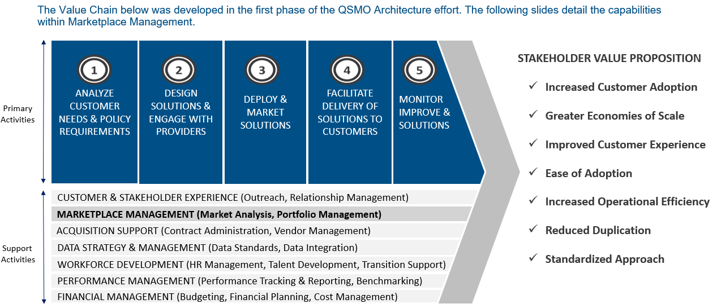
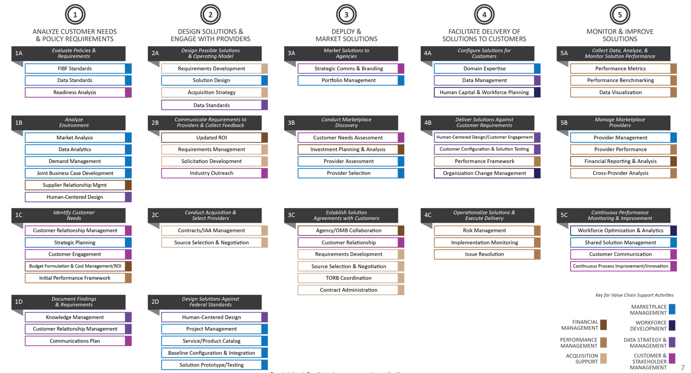
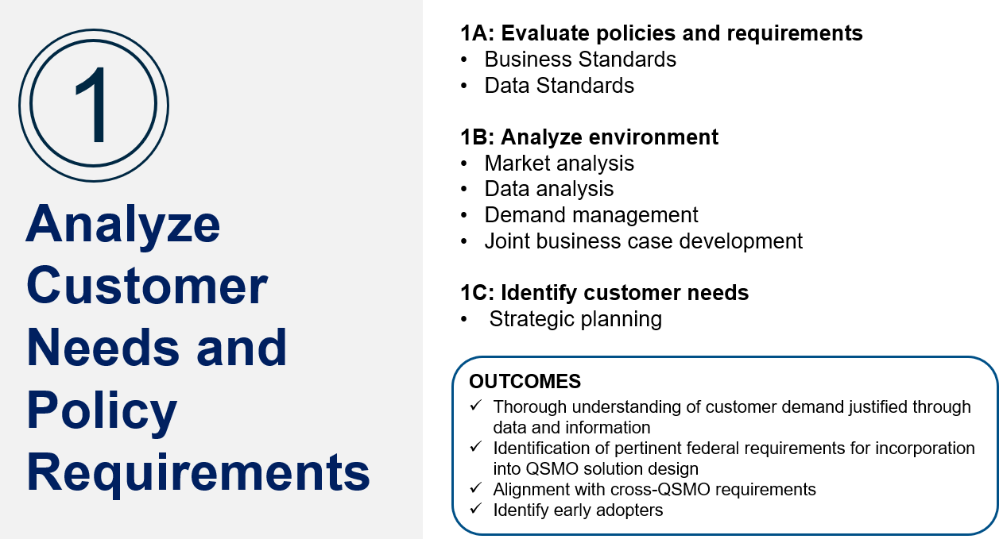
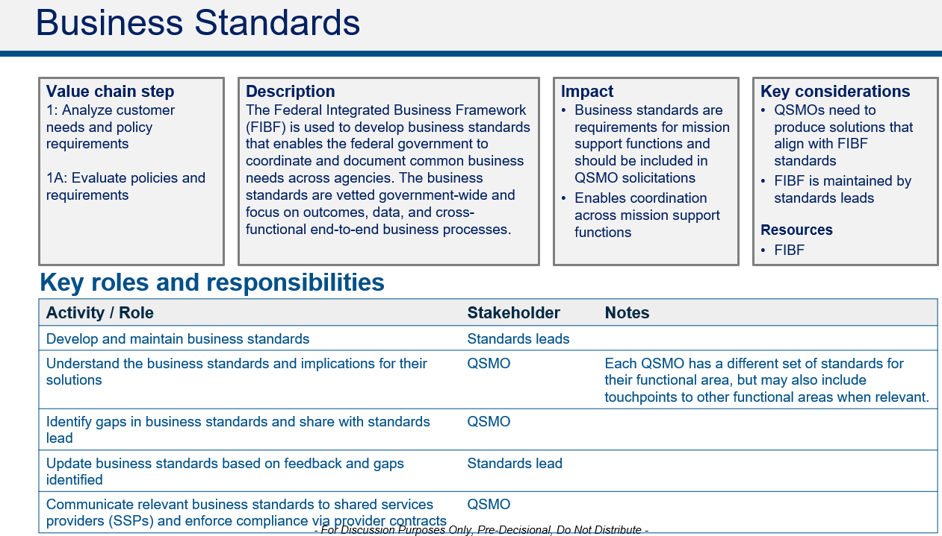
Table of Contents
Component | Description | Depiction
Value Chain | The Value Chain provides the QSMOs and relevant stakeholders the high-level sequence of activities needed to bring a solution to customers, as well as insight into how resources are consumed to support the primary activities.
Capability View | The Capability View provides a common framework by which each designated and future QSMO identifies, develops, and delivers solutions to customers.
Primary Activity Divider | The Primary Activity Divider lists the Marketplace specific capabilities (identified in the Capability View) and the overall outcomes of the Primary Activity.
Marketplace Capabilities | The Marketplace Capabilities provide a description of each capability, as well as the impact, key considerations, and roles and responsibilities within the Marketplace Capability. QSMOs can use these capabilities to ensure marketplaces are developed in a common manner.

Slide 4
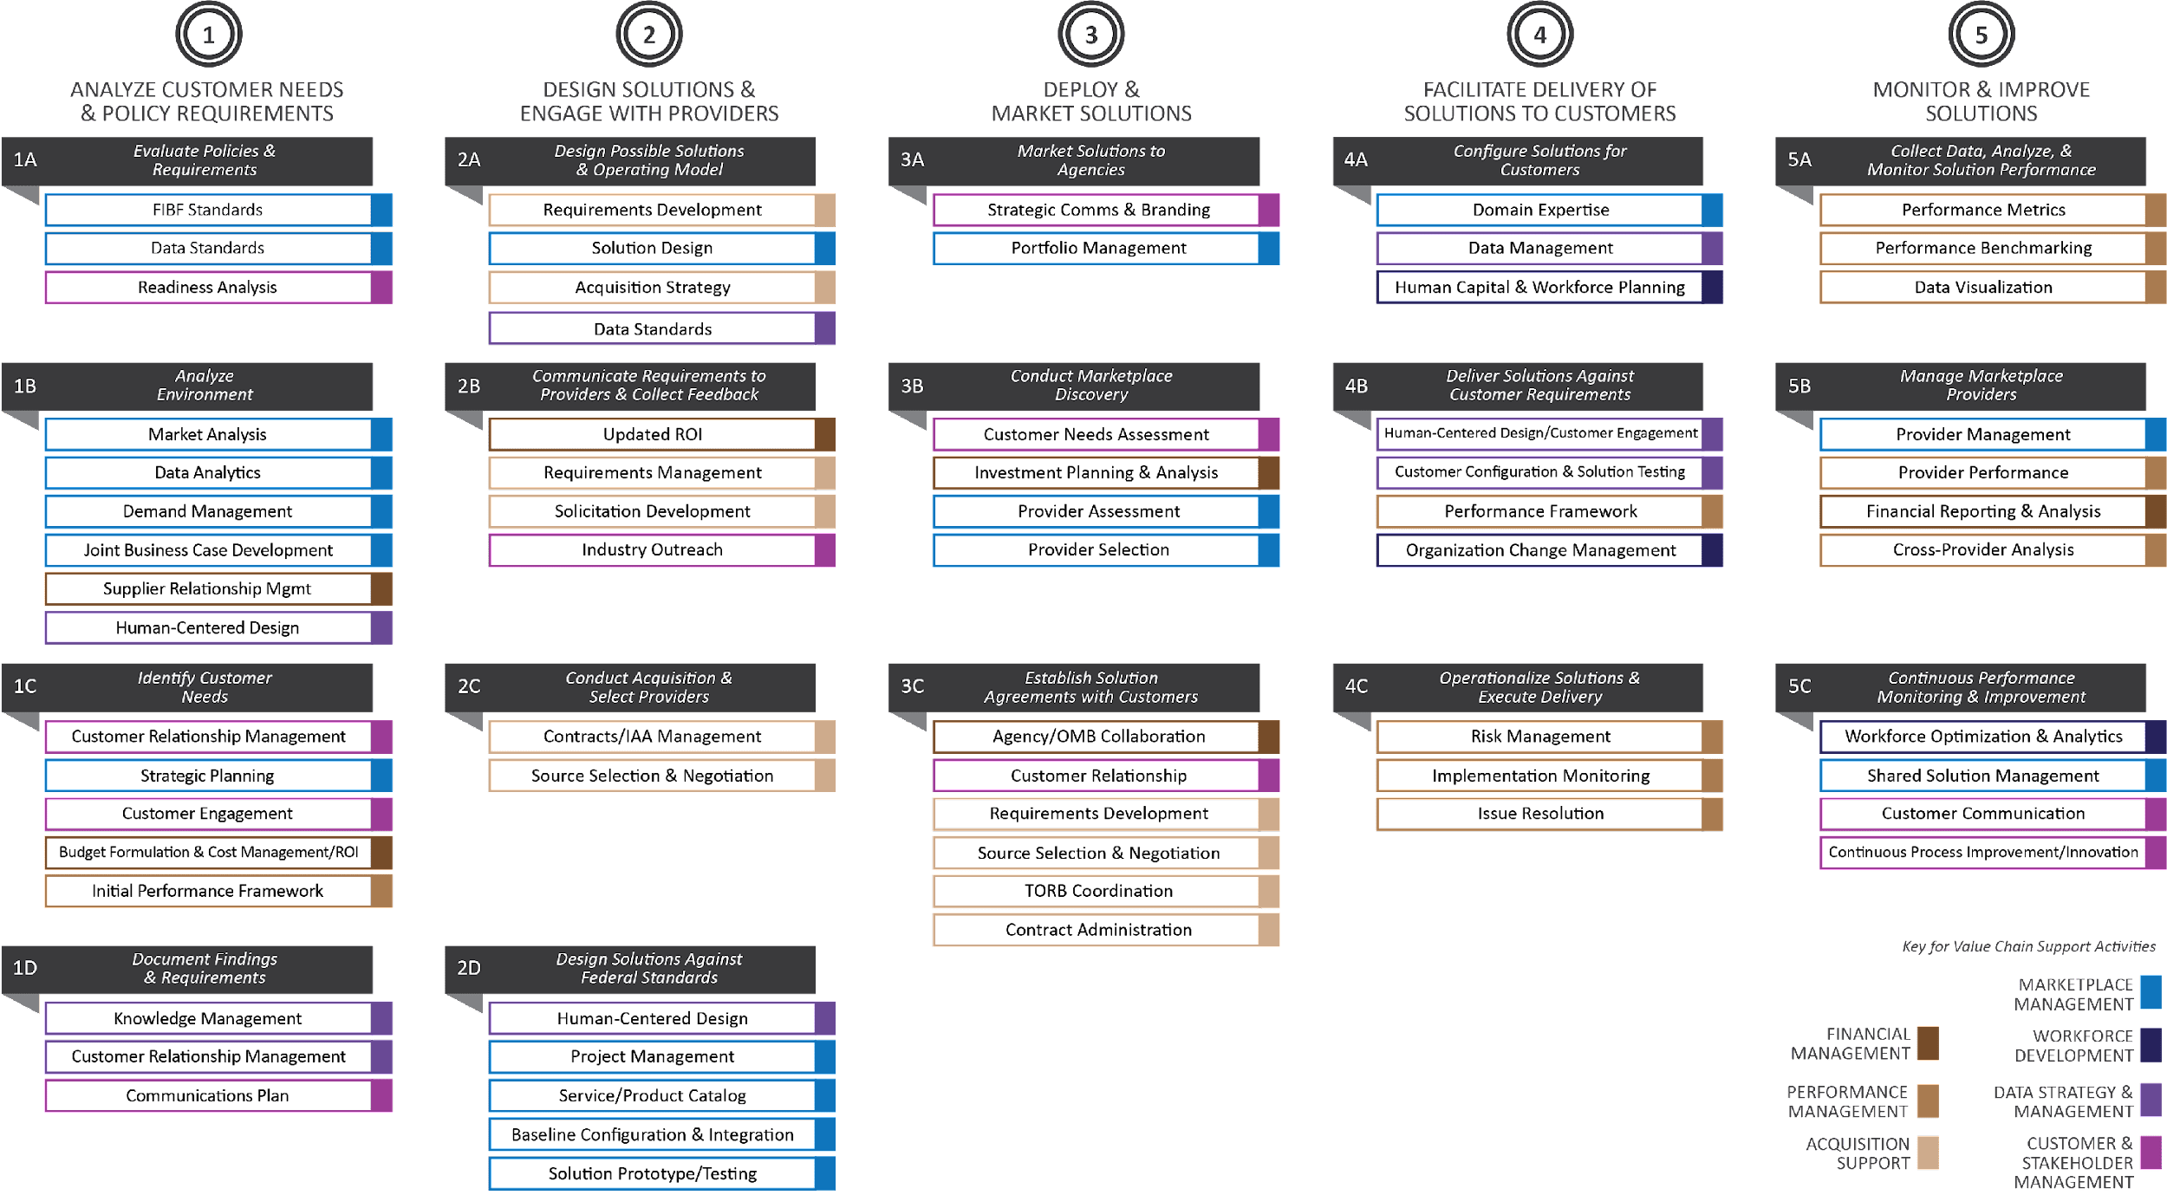
Value Chain
The Value Chain below is the premise of the QSMO Business Architecture. The following slides detail the capabilities within Marketplace Management.
ANALYZE CUSTOMER NEEDS & POLICY REQUIREMENTS
DESIGN SOLUTIONS & ENGAGE WITH PROVIDERS
DEPLOY & MARKET SOLUTIONS
FACILITATE DELIVERY OF SOLUTIONS TO CUSTOMERS
MONITOR
IMPROVE & SOLUTIONS
STAKEHOLDER VALUE PROPOSITION
Increased Customer Adoption
Primary
Activities
Greater Economies of Scale
Improved Customer Experience
Ease of Adoption
CUSTOMER & STAKEHOLDER EXPERIENCE (Outreach, Relationship Management)
Increased Operational Efficiency
MARKETPLACE MANAGEMENT (Market Analysis, Portfolio Management) )
ACQUISITION SUPPORT (Contract Administration, Vendor Management)
Reduced Duplication
Support
Activities
DATA STRATEGY & MANAGEMENT (Data Standards, Data Integration)
WORKFORCE DEVELOPMENT (HR Management, Talent Development, Transition Support)
Standardized Approach
PERFORMANCE MANAGEMENT (Performance Tracking & Reporting, Benchmarking)
FINANCIAL MANAGEMENT (Budgeting, Financial Planning, Cost Management)

Slide 5
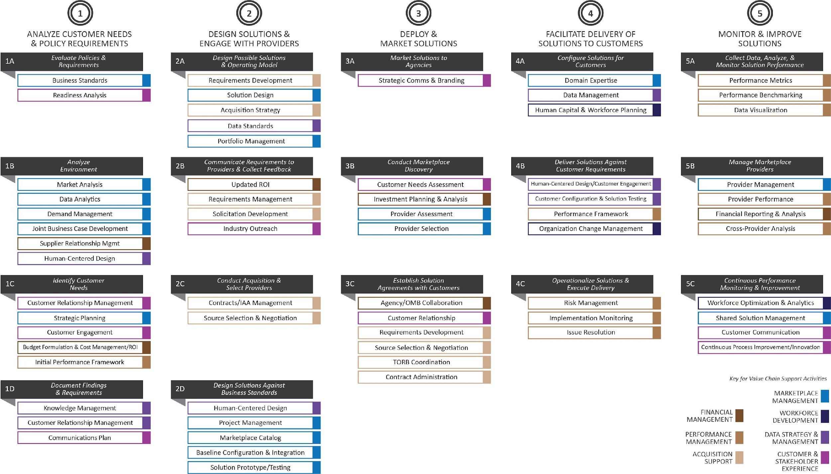
QSMO Business Architecture – Capability View

Slide 6
1A: Evaluate policies and requirements
Business Standards
1B: Analyze environment
Market analysis
Data analysis
Demand management
Joint business case development
1C: Identify customer needs
Strategic planning
1
Analyze Customer Needs and Policy Requirements
OUTCOMES
Thorough understanding of customer demand justified through data and information
Identification of pertinent federal requirements for incorporation into QSMO solution design
Alignment with cross-QSMO requirements
Identify early adopters

Slide 7
Business Standards
Value chain step
1: Analyze customer needs and policy requirements
1A: Evaluate policies and requirements
Description
The Federal Integrated Business Framework (FIBF) is used to develop business standards that enables the federal government to coordinate and document common business needs across agencies. The business standards are vetted government-wide and focus on outcomes, data, and cross-functional end-to-end business processes.
Impact
Business standards are requirements for mission support functions and shall be included in QSMO solicitations
Enables coordination across mission support functions
Key considerations
QSMOs need to produce solutions that align with business standards
Business Standards are maintained by standards leads
Resources
FIBF
Key roles and responsibilities
Activity / Role | Stakeholder
Develop and maintain business standards | Standards leads
Understand the business standards and implications for their solutions | QSMO
Identify gaps in business standards and share with standards lead | QSMO
Update business standards based on feedback and gaps identified | Standards lead
Communicate relevant business standards to shared services providers (SSPs) and enforce compliance via provider contracts | QSMO

Slide 8
Market Analysis
Value chain step
1: Analyze customer needs and policy requirements
1B: Analyze environment
Description
Market analysis captures information and insights about the current solutions available in the market. Through this ongoing activity, QSMOs gain a greater understanding of new, innovative, and best in class solutions to ensure that their marketplace considers and includes solutions that are at pace with the private/commercial sector.
Impact
Enables QSMOs to identify and engage best in class solution providers
Critical to QSMOs' competitive advantage over other solutions in the market
Key considerations
What questions do you need to ask/answer about each solution?
What factors are critical to your QSMOs decision to engage a provider for inclusion in the marketplace?
Key roles and responsibilities
Activity / Role | Owner
Develop analytical framework to guide market analysis | QSMO
Conduct research to identify solutions in the market that align with customer needs | QSMO
Engage with solution provider or conduct secondary research to navigate through the analytical framework | QSMO

Slide 9
Data Analytics
Value chain step
1: Analyze customer needs and policy requirements
1B: Analyze environment
Description
Data analytics entails translating data to insights. This includes creating and implementing a methodology for collecting, organizing, and analyzing customer needs to help inform QSMO marketplace solutions and operations. Data analytics enables QSMOs to ask and answer the right questions.
Impact
Key follow up to understanding business standards
Enables QSMOs to use data standards to inform decision making
Opportunity to influence customer experience
Key considerations
What questions do we need the data to answer?
Who is the audience for this analysis? How will they use it?
What data points/sources exist to inform the analysis?
Key roles and responsibilities
Activity / Role | Owner
Define standard/common data management processes | QSMO / OSSPI
Use data standards to identify data related to customer needs and policy requirements that require analysis | QSMO
Determine what questions the QSMO needs to answer through analysis | QSMO
Validate and cleanse data to align with standard/common data management processes and reveal unseen data patterns | QSMO
Leverage a Customer Relationship Management tool, advanced analysis, and data visualization techniques to better understand the story the data is telling / extract insights from the data (Reporting) | QSMO

Slide 10
Demand Management
Value chain step
1: Analyze customer needs and policy requirements
1B: Analyze environment
Description
Demand management is the process an organization puts in place to internally collect new ideas, projects, and needs during the creation of a strategically aligned portfolio. It reflects an understanding of the customers' desire for QSMO solutions. It considers customer needs and pain points, as well as how the agency plans to prioritize investments.
Impact
Understanding of customer demand will influence the supply made available through the marketplace
Opportunity to influence or shape customers' expectations and desire
Key considerations
What are customers asking for? What functionality or support do they need?
How urgent or time sensitive is the customer need?
What (new) policies may influence demand in the future?
Key roles and responsibilities
Activity / Role | Owner
Plan demand: Use data analytics to forecast / map out anticipated demand for QSMO solutions; consider engaging OSSPI for support in measuring demand and determining investment areas | QSMO
Communicate demand: Share internally and among other QSMOs via the monthly QSMO roundtable | QSMO
Influence demand: Execute strategic communications and marketing to shape future demand | QSMO
Prioritize demand: If there is an imbalance in supply and demand, prioritize demand to determine how the available supply will be distributed | QSMO

Slide 11
Joint Business Case for Legacy Providers
Value chain step
1: Analyze customer needs and policy requirements
1B: Analyze environment
Description
OMB Memo 19-16 directs legacy shared services providers (SSPs) offering services covered by a pre-designated or designated QSMO to propose a joint business case with the QSMO to accept any new customers, expand services to existing customers, or make investments in technology or services for these functions. These joint business cases must be approved by OMB in consultation with the SSGB. Not all QSMOs will have applicable legacy SSPs to engage.
Impact
Opportunity for legacy SSPs to affirm desire to be included in the marketplace
Explains how legacy SSPs plan to participate in the marketplace
Identifies exceptions to the marketplace
Key considerations
What role will the legacy SSP have in the future Marketplace as a provider? Does the role align with the strategic direction of the Department/Agency the SSP is in? Is the SSP committed to being an early adopter?
Resources
Investment Planning Guide (See page 18, Appendix B)
Key roles and responsibilities
Activity / Role | Owner
Collaborate with legacy SSP on joint business case | Legacy SSP and QSMO
Share initial thoughts on future marketplace role, accepting new customers, expanding services to existing customers, or making investments in technology or services based on the legacy SSP's existing solution(s) and solution early adoption | Legacy SSP and QSMO
Develop initial business case to justify requested action and submit to QSMO | Legacy SSP
Review and edit initial business case as needed | QSMO
Submit the joint business case and supporting documentation to OMB | Legacy SSP and QSMO
Inform the Investment Review Board (IRB) for legacy SSP's involvement in the marketplace | Legacy SSP and QSMO

Slide 12
Strategic Planning
Value chain step
1: Analyze customer needs and policy requirements
1C: Identify customer needs
Description
Strategic planning helps organizations chart a long term vision and actionable plan for achieving business goals. QSMOs should develop an annual strategic plan, conferring with other QSMOs and the Office of Shared Solutions and Performance Improvement (OSSPI) for input.
Impact
Opportunity for QSMOs to align long term plans and garner requisite support from OSSPI
Enables QSMOs to remain competitive
Key considerations
What are your marketplace maturity goals?
What business architecture capabilities drive your business forward?
What do customers expect?
Key roles and responsibilities
Activity / Role | Owner
Establish or reconfirm a mission, vision, and guiding principles for your QSMO | QSMO
Leverage customer data, market analysis, and other research to conduct an analysis or equivalent and understand current position in the market | QSMO
Use analysis to identify business goals and accompanying actions for achieving goals | QSMO
Share strategic plan with other QSMOs and OSSPI for feedback and support | QSMO

Slide 13
2A: Design potential solutions and operating model
Solution design
Portfolio management
2D: Design solutions against business standards
Project management
Marketplace catalog
Baseline configuration and integration
2
Design Solutions and Engage with Providers
OUTCOMES
Access to innovative solutions that meet business standards and requirements
Leverage preferred contract vehicles for customer agency ease of use and quick delivery
Align QSMOs and customer agencies on acquisition strategies
Validation that services and solution are performing as designed
Accelerate adoption through appropriate configuration and testing

Slide 14
Solution Design
Value chain step
2: Design solutions and engage with providers
2A: Design possible solutions and operating model
Description
Use ideation techniques to translate customer needs, system requirements, and policy/compliance mandates to design solutions that offer customers greatest value
Impact
Produces innovative solutions that meet customer requirements and work in government settings
Enables QSMOs to remain competitive
Key considerations
Who should be involved in solution design?
What is makes the QSMO marketplace the first choice for customers seeking solutions?
What do your customers need/expect?
Key roles and responsibilities
Activity / Role | Owner
Organize data on customer needs, policy mandates, and system requirements into a cohesive report | QSMO
Use human centered design (or equivalent) ideation techniques to develop creative solutions that meet customer needs | QSMO
Identify key use cases for the solution and validate market demand | QSMO

Slide 15
Portfolio Management
Value chain step
3: Deploy and market solutions
3A: Market solutions to agencies
Description
Centralized management of processes, methods, and technologies to analyze and collectively manage current or proposed QSMO solutions.
Impact
Provides data and analysis required for decision making and adequate oversight of the QSMO solution portfolio
Contributes to customer experience; ability to retain customers and attract new ones
Key considerations
What is the expected value and impact of each QSMO solution?
How will we manage potential risks and issues for QSMO solutions?
Key roles and responsibilities
Activity / Role | Owner
Identify a Portfolio Manager to manage current and proposed QSMO solutions | QSMO
Establish a strategy, inclusive of a vision and/or guiding principles, for managing QSMO solutions | QSMO
Manage solutions that align with vision and guiding principles | QSMO
Monitor and analyze evaluate solution and provider based on performance management framework to ensure high quality service and customer experience | QSMO
Make recommendations for on-boarding, amending, and off-boarding solutions and providers as needed | QSMO
Pre-decisional. For discussion purposes – do not distribute.

Slide 16
Project Management
Value chain step
2: Design solutions and engage with providers
2D: Design solutions against business standards
Description
Employ agile project management techniques to establish a cohesive marketplace that includes shared solutions that are compliant with business standards and meets functional requirements.
Impact
Supports timely and fiscally responsible prototype development
Agile development enables speedy delivery of value to the end user
Key considerations
What resources are available for prototype development and managing the project?
What agile framework makes the most sense for your organization? Scrum? Kanban?
Key roles and responsibilities
Activity / Role | Owner
Define project vision/objectives and initiate project | QSMO
Develop the product roadmap, backlog, and release plan | QSMO
Conduct sprint planning, kick off sprint cycle, and accompanying ceremonies | QSMO
Test and iterate on potentially usable product increment or minimum viable product | QSMO

Slide 17
Marketplace Catalog
Value chain activity
2: Design solutions and engage with providers
2D: Design solutions against business standards
Description
The marketplace catalog is an online resource that allows customers to retrieve product information required to make a buying decision. The marketplace catalog is a communication vehicle that enables QSMOs to share content that supports a customers' decision to procure QSMO products and services.
Impact
Primary point of customer engagement
Provides customers with information required to procure QSMO products
Opportunity to improve customer experience through automated functionality
Key considerations
What data/information will customers need?
How much will customers know when they visit the catalog?
What is the best way to format and organize information?
Key roles and responsibilities
Activity / Role | Owner
Conduct research to understand customer needs and expectations and align with QSMO customer experience strategy | QSMO
Document functionality requirements; align with key catalog elements and marketplace maturity framework within the Marketplace Implementation Guidebook | QSMO
Document content requirements and align with QSMO communication strategy | QSMO
Develop wireframe or prototype and test with users | QSMO

Slide 18
Baseline Configuration and Integration
Value chain step
2: Design solutions and engage with providers
2D: Design solutions against business standards
Description
Configure solutions to meet business standards. The baseline configuration should be based on the business standards and government-wide customer needs for the solution.
Impact
Supports development of a minimum viable product that broadly meet customer requirements and aligns with business standards
Key considerations
What resources are available within the QSMO to support adequate customer engagement and research?
Key roles and responsibilities
Activity / Role | Owner
Leverage business standards to identify initial requirements for baseline configuration | QSMO
Engage potential customers to understand needs for government-wide configuration and augment configuration requirements | QSMO
Validate baseline configuration requirements with potential solution providers | QSMO
Finalize baseline configuration requirements and integrate into solution design | QSMO

Slide 19
3B: Conduct marketplace discovery
Provider assessment
Provider selection
3
Deploy and Market Solutions
OUTCOMES
Market awareness of solutions and success stories to increase adoption
Secured funding to invest in shared solutions
Signed agreements with customers (if applicable)
Interoperability across QSMO solutions

Slide 20
Provider Assessment
Value chain activity
3: Deploy and market solutions
3B: Conduct marketplace discovery
Description
QSMOs evaluate both providers and their solutions to determine if the solution is suitable for inclusion in the QSMO marketplace. This includes ensuring capabilities align with customer needs/demand, compliance regulations, and industry best practices.
Impact
Supports supply of competitive solutions in the marketplace
Opportunity to create consistency in provider requirements across QSMOs
Key considerations
What factors contribute to a potential provider's suitability for your marketplace?
What gaps/risks are acceptable?
Key roles and responsibilities
Activity / Role | Owner
Develop an evaluation process to assess a potential provider's alignment with customer needs and QSMO priorities | QSMO
Conduct assessment to determine provider suitability for inclusion in the QSMO marketplace; this may include provider demos | QSMO
Identify gaps in provider alignment | QSMO
Collaborate with the potential provider to identify potential impacts and mitigation strategies for gaps in alignment | QSMO

Slide 21
Provider Selection
Value chain activity
3: Deploy and market solutions
3B: Conduct marketplace discovery
Description
A consistent approach for assessing solution providers and solutions and admitting new solutions to the marketplace.
Impact
Efficiency of selection process will impact ability to maintain a competitive selection of providers
Onboarding will impact provider experience and speed to market for new solutions
Key considerations
Who should be involved in the selection process?
Who needs to approve the final selection?
Key roles and responsibilities
Activity / Role | Owner
Develop a governance process for reviewing and finalizing the provider assessment | QSMO
Identify key stakeholders (individuals and organizations) who need to be involved in the final selection process | QSMO
Conduct provider selection that will comprise of the commercial vendors in the marketplace | QSMO
Gather requisite feedback and approvals to admit provider to the marketplace | QSMO
Conduct provider onboarding | QSMO

Slide 22
4A: Configure solutions for customers
Domain expertise
4
Facilitate Delivery of Solutions to Customers
OUTCOMES
Customer migration to shared solutions
Customer satisfaction with provider performance and QSMO support services
Improved agency performance
Successful solution implementation through effective program, risk and change management

Slide 23
Domain Expertise
Value chain step
4: Facilitate delivery of solutions to customers
4A: Configure solutions for customers
Description
The QSMO will be uniquely positioned to offer expert guidance on its functional domain. To prepare the solution for delivery to customers, the QSMO should collaborate with providers to configure the solution per business standards and customer needs. The QSMO supports this process by providing domain expertise.
Impact
The QSMO's expert domain guidance supports delivery of solutions that meet business needs and are appropriate for use in government settings
Key considerations
What environmental nuances or policy requirements must the provider consider during configuration?
Key roles and responsibilities
Activity / Role | Owner
Collaborate with customers to determine how to support solution configuration in a consultative capacity | QSMO
Provide ongoing insight and guidance throughout configuration to ensure solutions are in line with business standards and customer needs | QSMO
Identify new requirements for baseline configuration (based on new/emerging customer needs and policy requirements) | QSMO
Document lessons learned and best practices for shared services integration and share with customers, the QSMO community, and OSSPI | QSMO

Slide 24
5B: Manage marketplace providers
Provider management
5C: Continuous performance monitoring and improvement
Shared solution management
5
Monitor and Improve Solutions
OUTCOMES
Customer solutions advance with market dynamics
QSMO Marketplace evolves in alignment with customer demand
Supplier performance is effectively monitored and adjusted, if needed, to maintain customer satisfaction

Slide 25
Provider Management
Value chain activity
5: Monitor and improve solutions
5B: Manage marketplace providers
Description
The QSMOs exist to support consistent delivery of high quality shared services across the government. Managing providers entails tracking performance, facilitating customer relationships, and providing feedback to support quality and compliance.
Impact
Opportunity to support consistent service quality and customer experience
Reduces administrative burden on customers
Key considerations
What systems, processes, or tools can be leveraged to support provider management?
Is there an opportunity to create consistency across the QSMOs?
Key roles and responsibilities
Activity / Role | Owner
Develop and implement repeatable approach/methodology for monitoring provider performance and identifying opportunities for improvement | QSMOs
Provide feedback on solicitations/RFPs and other QSMO business interactions | Providers
Continuously conduct market analysis to remain abreast of best in class providers and industry leaders | QSMO
Conduct analysis to determine whether we need additional providers | QSMO
Complete CPARS assessment(s) and provider satisfaction surveys if applicable to evaluate provider performance | QSMO Customer

Slide 26
Shared Solution Management
Value chain activity
5: Monitor and improve solutions
5C: Continuous performance monitoring and improvement
Description
Conduct ongoing portfolio management and shared solution management. Identify opportunities to integrate new solutions, update existing solution functionality, or sunset aging solutions.
Impact
Contributes to customer experience; ability to retain customers and attract new ones
Requires ongoing monitoring, which support performance management
Key considerations
Align approach with performance management framework
Key roles and responsibilities
Activity / Role | Owner
Continuously monitor market alternatives to remain abreast of best in class solutions and industry best standards | QSMO
Establish an ongoing cadence for evaluating solution performance, customer satisfaction, and customer performance based on the QSMO performance management framework | QSMO
Incorporate customer feedback to make recommendations for new solutions, updates to existing solution functionality, or sunset aging solutions | QSMO

Slide 27
Appendix

Slide 28
Notes
Capability | Notes
Business Standards | Data standards fall within the FIBF Each QSMO has a different set of standards for their functional area, but may also include touchpoints to other functional areas when relevant Communicate across QSMOs as applicable
Market Analysis | Consider developing a guiding principle to conduct market analysis annually
Strategic Planning | Who do we want to be? Who are we now? How do we get closer to our ideal? How can we work together to achieve these goals?
Provider Assessment | Review FAR 15.1 for source selection and techniques
Provider Management | Reference Provider Selection as needed

Slide 29
Glossary of Terms
Acronym | Term
QSMO | Quality Service Management Office
FIBF | Federal Integrated Business Framework
OSSPI | Office of Shared Solutions and Performance Improvement
SSP | Shared Service Provider
OMB | Office of Management and Budget
SSGB | Shared Services Governance Board
IRB | Investment Review Board
CPARS | Contractor Performance Assessment Reporting System

